Slide 1
Scientific Knowledge and the Aesthetic Appreciation of Nature
Patricia Matthews

Slide 2
Issues in assessing aesthetic value
Some view that nature, aesthetically speaking, doesn’t offer the depth, complexity and meaningfulness of art.
Assuming aesthetic value contributes to the overall value of nature
Environmentalists say: no. Science gives us depth to nature. Decisions made on aesthetic grounds conflict with preservationalists’. Aesthetic grounds favor beauty.
Latter claim may be equally or more important

Slide 3
Carleson’s Model
Scientific knowledge is necessary for determining categories of nature.
In categorizing, science focuses our attention on relevance.
Our aesthetic appreciation therefore considers the role of the object in the system, thus gives us a greater appreciation.
Mundane nature becomes more interesting and our ethical and aesthetic assessment become harmonious.

Slide 4
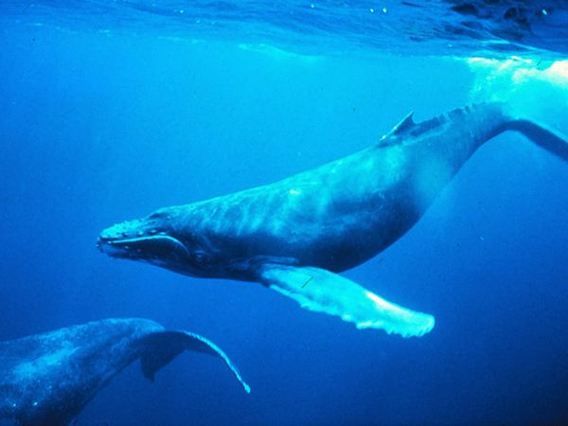
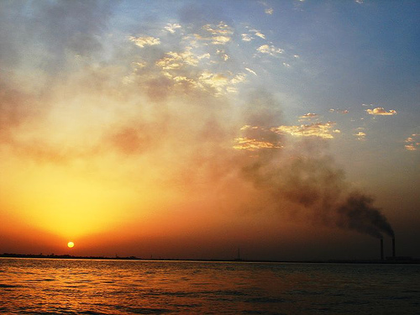
Criticisms
Noel: Animal as a whale vs. fish.
We can still appreciate the grandeur of an animal.
Learning something doesn’t change its aesthetic value.
A sunset is no less beautiful when we learn colors are enhanced by pollution.

Slide 5
Matthews’ Issues:
Scientific knowledge is vast. We don’t have guidelines telling us what is relevant.
Science doesn’t offer us any rules for appreciation.
What piece of information is more relevant than another? (Chemistry, botany, physics, ecology, when appreciating a flower?)
Everything in nature isn’t aesthetically valuable.
Attempts to narrow a broad range of empirical knowledge.

Slide 6
Matthews:
Responds to Carroll’s claim on behalf of Carleson, defending a cognitive account.
Uses Carleson’s claim that scientific categories function like art categories.
Categories are required in order to correctly appreciate nature.
We need categories.

Slide 7
Categories
Provide us with norms for nature appreciation.
Standard: A property which includes that object in a category.
Contra-standard: A property that might remove an object from a category.
Variable: Doesn’t affect an objects inclusion in a category.
Are perpetually indistinguishable.
Tell us what something is.

Slide 8
Empirical Knowledge
Lets us know what it is.
Linguistic Model: We essentially “read nature.”
Ex: A biologist connects the color of an egg with evolutionary knowledge. The evolutionary story is important, not the color of the egg.
Perceptual Model: based on what we perceive.
Having knowledge changes our aesthetic perception. Knowledge of the evolutionary forces affects how we see the egg’s aesthetic properties.

Slide 9
Walton claims:
Aesthetic properties in art turn on what’s perceived in the work; what’s perceived is dependent on knowledge and experience.
Matthews- this is true of nature.
Correct perception starts with the correct perception of a scientific fact.

Slide 10
Carleson:
Empirical knowledge is used for viewing under categories, not just knowing information.
We want knowledge giving us perceptual norms.
ie: indicating which features are standard, contra-standard, and variable.
Ex: knowing kinds of trees, and how they compare with other plant life. Pg. 40 Live oaks

Slide 11
Contrastingly, the chemical composition of the trees bark will not contribute to the perceptual norms and therefore is not relevant.
Consider a painting.
The color used is variable.
The painting’s weight and chemical composition is not relevant to the category it is perceived under.

Slide 12
So,
The range of our empirical knowledge relevant to our aesthetic appreciation is limited. Features must be ones which directly affect how we perceive an object.
Carroll and Stecker argue, and Matthews rejects that: even relevant information can be ignored for simple, but valid, appreciation of nature.

Slide 13
Perceptual Cognitive Model
Two ways to envision: the “enhancement” model and the “pure” model.
Enhancement Model:
Provides us with “thin” and “thick” conceptions of nature.
A “thin” conception focuses on surface qualities.
A “thick” conception adds levels of knowledge, helping us to perceive nature in more complex ways.
Compare “thin” surface qualities of a flower to a “thicker” appreciation that occurs when one knows that the flower indicates a certain stage of spring.

Slide 14
Stecker:
Having further knowledge is like throwing on more layers of clothes. The new layers don’t affect the old ones, though they might provide us with warmth.
Layers are optional.
We don’t affect our original knowledge, we just enhance it, thus enhancing appreciation.
Matthews: NO. We can’t just assume certain things.
A “thinner” conception is problematic. Sometimes with a “thicker” conception we just enhance our knowledge, but other times we correct our knowledge.
Tidal Basin example. Our knowledge is corrected.

Slide 15
The Pure Perceptual Model
Distinguishes thinking and perceiving.
Thinking distinguishes clear aspects that are known and aspects unknown. We leave gaps in knowledge to be filled at a later date.
Know moss on a tree, though uncertain of its size, shape etc.
Perceiving allows for gaps to be filled automatically. We don’t refrain from perceiving things the way we refrain from thinking about them.
We can perceive the tree as large/small, sparse/full

Slide 16
Matthews
If we agree with Carleson that there are correct and incorrect ways of nature appreciation, then “thicker” conception is required (for a confirmation of our original knowledge).
Partial representations are inadequate if they mislead us.
Only knowing part of the truth distorts the aesthetic properties perceived.
A “thicker” conception sometimes only enhances what’s perceived, though sometimes it corrects our knowledge.
We can’t know they mislead us until we have the accurate knowledge.

Slide 17
Sometimes…
Scientific knowledge doesn’t change our aesthetic judgment.
Loosestrife example.
Perceiving takes time and experience. We have to see the plant as harmful, not just think it for our aesthetic perception to change.
Our aesthetic perception will change. At the very least, the quality of beauty will change in seeing the plant as beautiful and harmful.

Slide 18
Another example:
A child is a victim of abuse.
A large multicolored bruise taken out of context without knowledge of the significance of the color variation. We might find it beautiful.
Seeing the mark under the concept of child abuse changes the aesthetic character entirely.
We probably won’t look at it as beautiful anymore. If we can look at it as sad and beautiful, the sadness pervades the beauty and changes its aesthetic quality.

Slide 19
There’s no a priori connection between empirical knowledge and aesthetic properties of the object.
Thus, we can appreciate objects while getting a category wrong.
Getting some facts wrong doesn’t necessarily result in false aesthetic judgment—that is if it doesn’t have a bearing on our aesthetic response and doesn’t make it deficient.

Slide 20
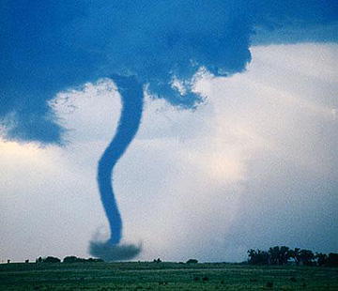
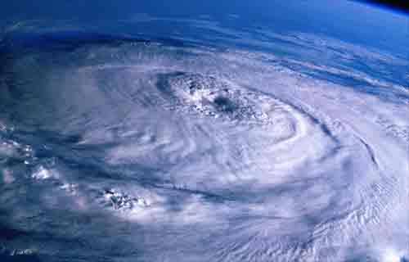
Experience
Empirical knowledge alone can’t guarantee any particular aesthetic value. Context can’t be a sole factor in determining value.
Experience is important as well as knowledge.
Hurricane vs. Tornado example

Slide 21
In appreciating,
We listen to the naturalist. We value their knowledge. The naturalist focuses on perceptible properties of the object, properties discovered through careful observation.
These properties she focuses on are the ones most likely to alter our aesthetic appreciation.
Seeing destructive properties will change our aesthetic appreciation of an object, just as in art.

Slide 22
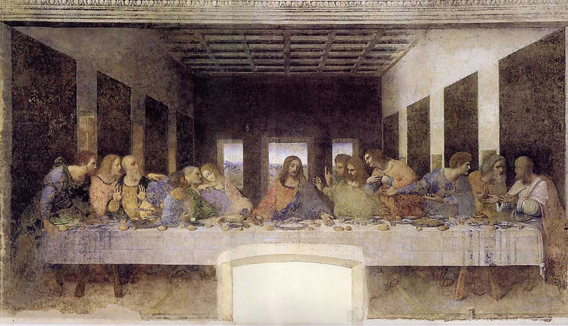
Art Restoration
Critics are divided on whether the restoration of The Last Supper is aesthetically better or not.

Slide 23
Do we need strictly scientific knowledge?
Only relevant information can change how we perceive it.
Until we put objects into categories, we can’t know how those objects will change for us.
Judgments based on visceral emotions are altered or corrected when we learn more about the object.
Ex: seeing a pet rat. Initially we may find it scary. After getting to know the animal we may find it sweet, loving, and harmless.
Our initial aesthetic judgment based on visceral emotion might be that its disgusting, but later we might change our assessment to find the rat sleek and not disgusting.

Slide 24
Assessment
If we want to be correct in assessing, we should know more. Even if the knowledge only enhances and might not change our original assessment.
It’s not irrelevant to find out more information, because you don’t know.

Slide 25
Correct vs. Justified
Aesthetic assessments may never be correct, as we’re continually finding out more about nature.
With experience, we can draw generalizations about what scientific knowledge makes a difference.
We might focus on justification rather than correctness. Empirical knowledge better justifies our judgments of nature.

Slide 26
Multiple Categories
There are many ways of categorizing. This may lead to conflicting aesthetic properties.
Example: A deer might be seen as a graceful animal, but an awkward deer.
There’s a problem at the level of generality and finding the right category. Some might fall into two categories.
This is true of art as well.

Slide 27
Focus
Chemistry is not usually important in a broad context, but what if we are looking at tree bark underneath a microscope?
Do we treat it independently or as part of a whole?
What category do we place it under?

Slide 29
Nature vs. Art
For any given object, there are ways to broaden or narrow the context of the object, or its spatial temporal frame. It is hard to delineate because of the depth.
Nature compared to art is particularly thick.
Art is easy to distinguish physical properties (we don’t care about the canvas or the wood frame).
With nature we care about the façade of the tree bark as well as the rings on the inside.
Art has permanence. Nature changes and develops. Nature has surface depth. The range of relevant knowledge is greater for nature than for art.

Slide 30
There is an implicit dissimilarity in the categories for appreciating art vs. appreciating nature.
Nature doesn’t reveal its aesthetic purpose or standards.
Carleson argues that objects seen through categories will have positive aesthetic qualities.
So science offers aesthetic goals because its guided by aesthetic standards.

Slide 31
Problems with Carleson
Science won’t explicitly guide us to aesthetic criteria.
The range of relevant knowledge is not limited for aesthetic criteria.
Aesthetic properties must be empirically discovered.
There’s no way to know in advance of experience how all the properties will play together—or if they will be positively aesthetic.

Slide 32
Nature is comparable to art in aesthetic purposes offered by art categories.
We can take a look at how certain objects play a role in their system.
Admire an animal fulfilling its role.
Or a species adapting to its surroundings.
Scientific knowledge is relevant if were giving categories of function.

Slide 33
Scientific knowledge is relevant because its gets to the nature of nature—therefore required for aesthetic appreciation.
This provides perceptual norms of nature.
Categories in art provide a guide for the function of empirical knowledge in nature.

