Slide 1
Moral Reasons to Recycle
Ned Hettinger
Philosophy Department

Slide 2
Should one recycle?
Of course!
It’s a moral obligation
It’s part of being a virtuous person
A way of living more gently on Earth
Sharing the planet with other creatures and other humans

Slide 3
Output or input focus?
Output focuses on waste side
Waste management crisis: Where do we put all our trash?
Ends up in oceans
Poisons our land
Important reason to recycle: To lessen our waste stream
I approach issue mainly from input side
The “taking from the earth” side
Rather than putting back side

Slide 4
Humans are overusing the planet
Consume 30-40% of net primary production
Consume over ½ all surface fresh water
Overfish the oceans devastating sea life
Dams control water flow in most major rivers
Changing climate, messing with ecosystems
Driving other life forms extinct 100-1000 times
Taken over 70% of planet’s usable land

Slide 5
Obligation to fairly share planet
Our use is unfair to other species with whom we share planet
Most important reason to recycle is to avoid having to go back to the earth for more
We’ve taken from earth for our needs/desire
Now should recycle/reuse what we’ve taken, rather than going back for more
Part of humans sharing planet with others

Slide 6
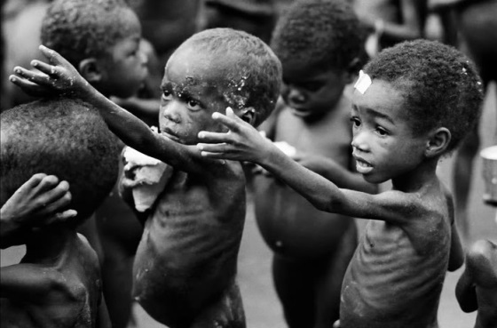
Life of moderation instead of greed and wastefulness
Humans as gluttons: Big fat pigs, coming to a beautiful and well stocked table and taking most for themselves and throwing much out
Virtue requires taking less, wasting less, reusing and recycling—a life of moderation
Especially Americans who overconsume most
With 2 billion people living in extreme poverty, its obscene to be greedy and wasteful

Slide 7
Objections
Individual recycling makes no difference
No impact whether I throw away or recycle coke can
Individual action ineffective
Need collective action
Replies:
Need both
Setting an example
Right thing to do even if makes no difference
Recycling is a diversion
People think discharged green duties by recycling
They recycle but don’t pay attention to candidates environmental records
Replies:
Recycling not a cure all
Part of broad range of needed actions, such as
Buying recycled products
Reusing
Lowering consumption
Much more

